Slide 1
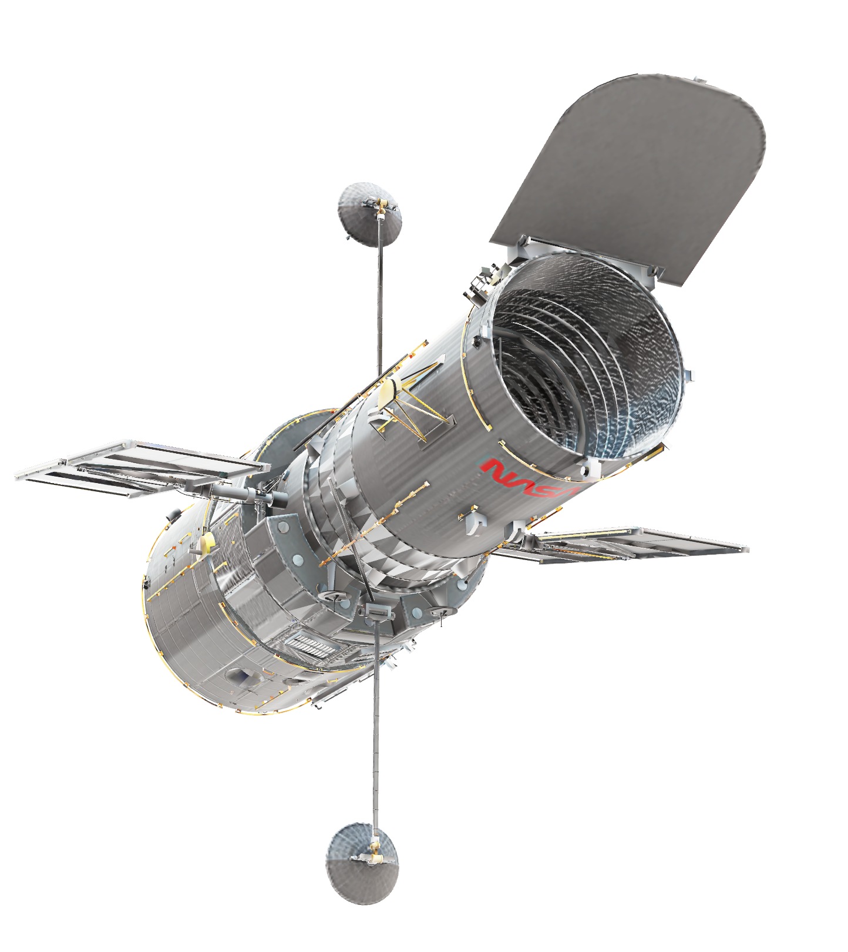
EXOMUNDUS
Planet builder

Slide 2
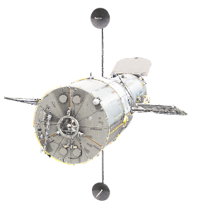
PROBLEM
Lack of access to basic astronomy information
Time lag in the study of astronomical sciences
What is the biggest difficulty you have today in teaching astronomy basics to your students today?
6 answers
My students have difficulty reading and focusing
Children have a very low level of education in complementary fields such as math, physics, biology, chemistry, geography and the like. They are usually of great interest but a lagged knowledge that hinders the transmission of knowledge.
The difficulty of many students not paying attention to anything other than digital
The visualization of concepts that depend on geometry as elements of the celestial sphere.
The deficiency of basic physics and mathematics required for astronomy.
Understand the classroom to adapt classes (if students better understand kinesthetic, auditory or visual methods)

Slide 3
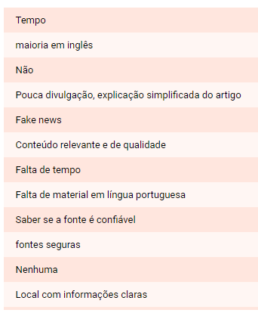
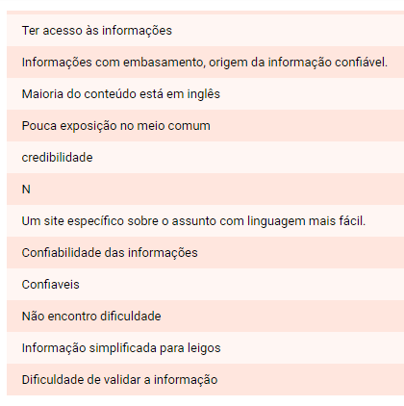
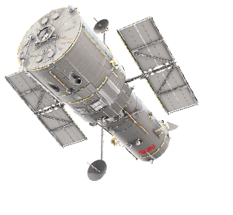
PROBLEM
What is the greatest difficulty you have today in finding astronomy information?

Slide 4

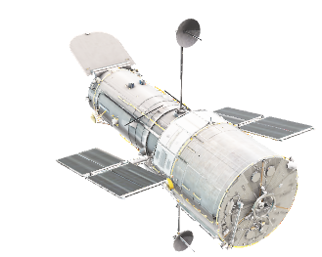
OPPORTUNITY
In 2017, the games sector, which includes board [..], had revenues of $ 567 million, 6% higher than in 2016, according to the Brazilian Association of Toy Manufacturers. That is, the boards are quickly invading bar tables, YouTube channels and the homes of thousands.

Slide 5
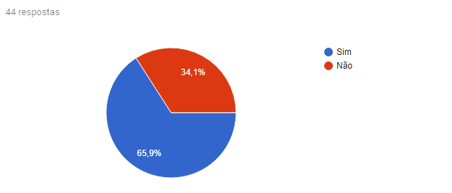
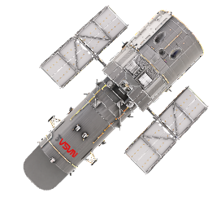
GENERAL MARKET
Do you often look for information on astronomy and new discoveries in this area?

Slide 6
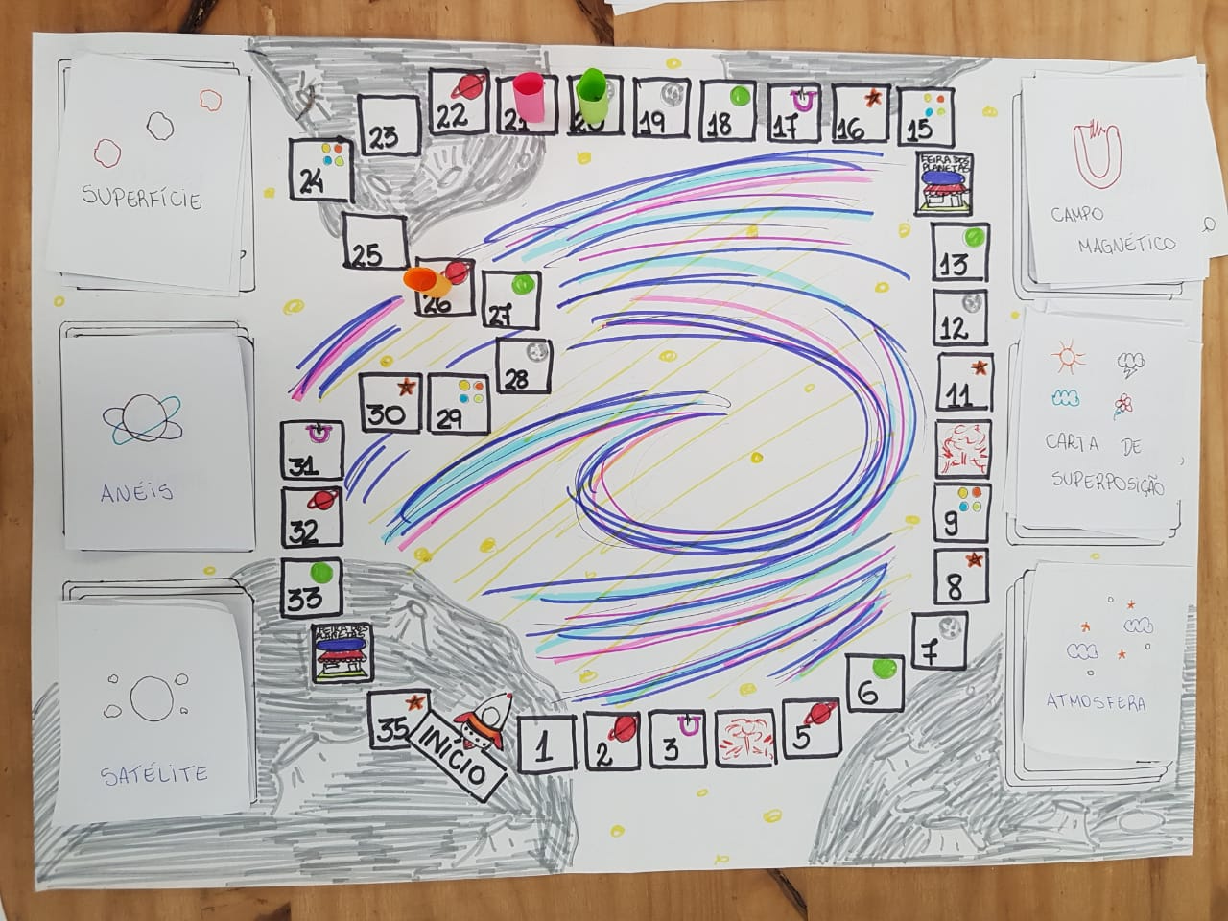
EXOMUNDUS: PLANET BUILDER

Slide 7
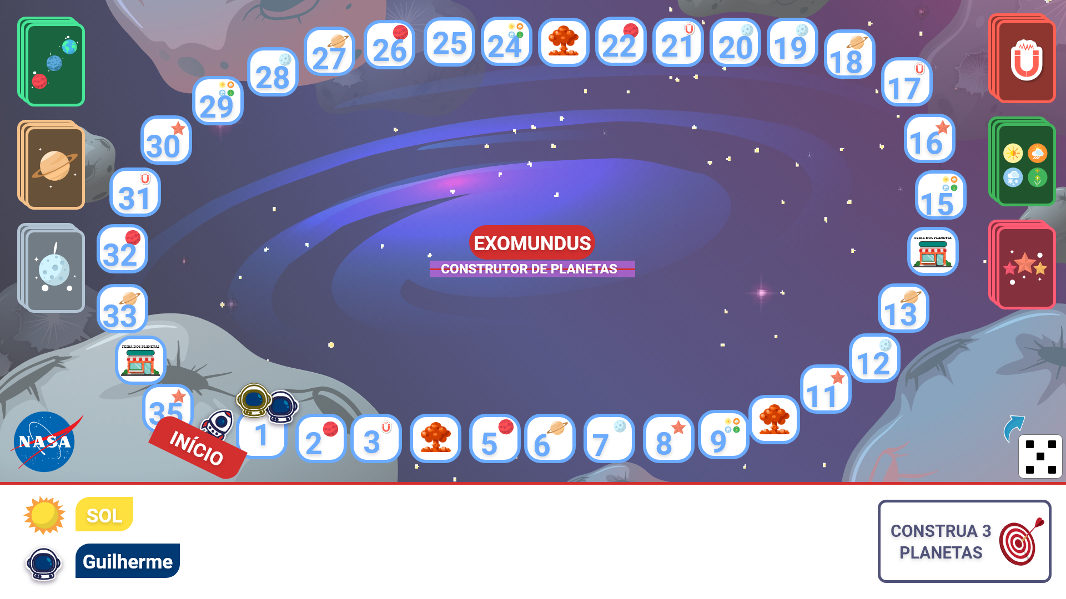
EXOMUNDUS: PLANET BUILDER

Slide 8
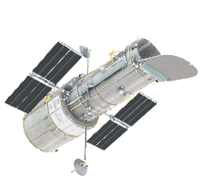
THE GAME
DESCRIPTION:
The idea of ​​the EXOMUNDUS game is to use an educational approach to teach basic astronomy and star-related concepts in our galaxy through a competitive challenge among players.
AGE: From 10 years old
NUMBER OF PLAYERS: 2-5 players
GOALS:
Players must accomplish one of the 20 objectives that involve creating planets according to the characteristics defined for the constitution of a star system.

Slide 9
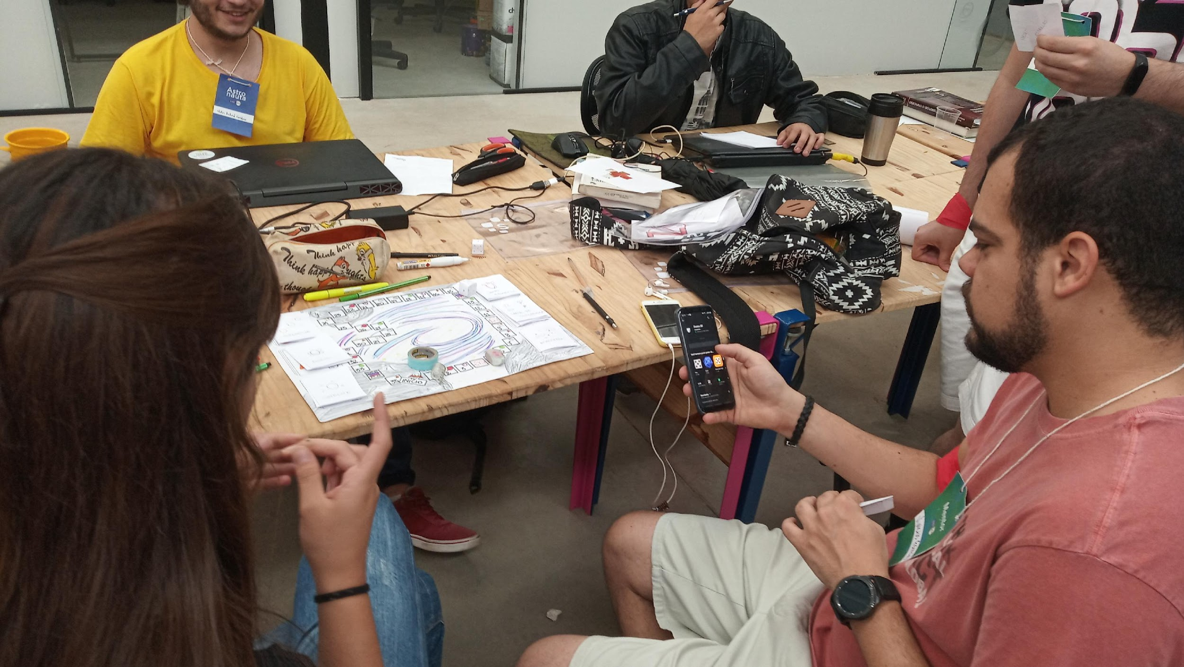
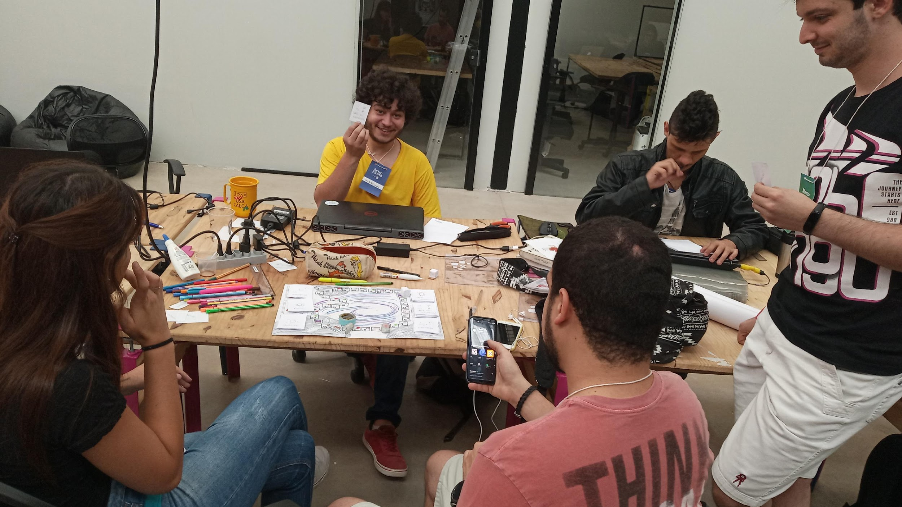
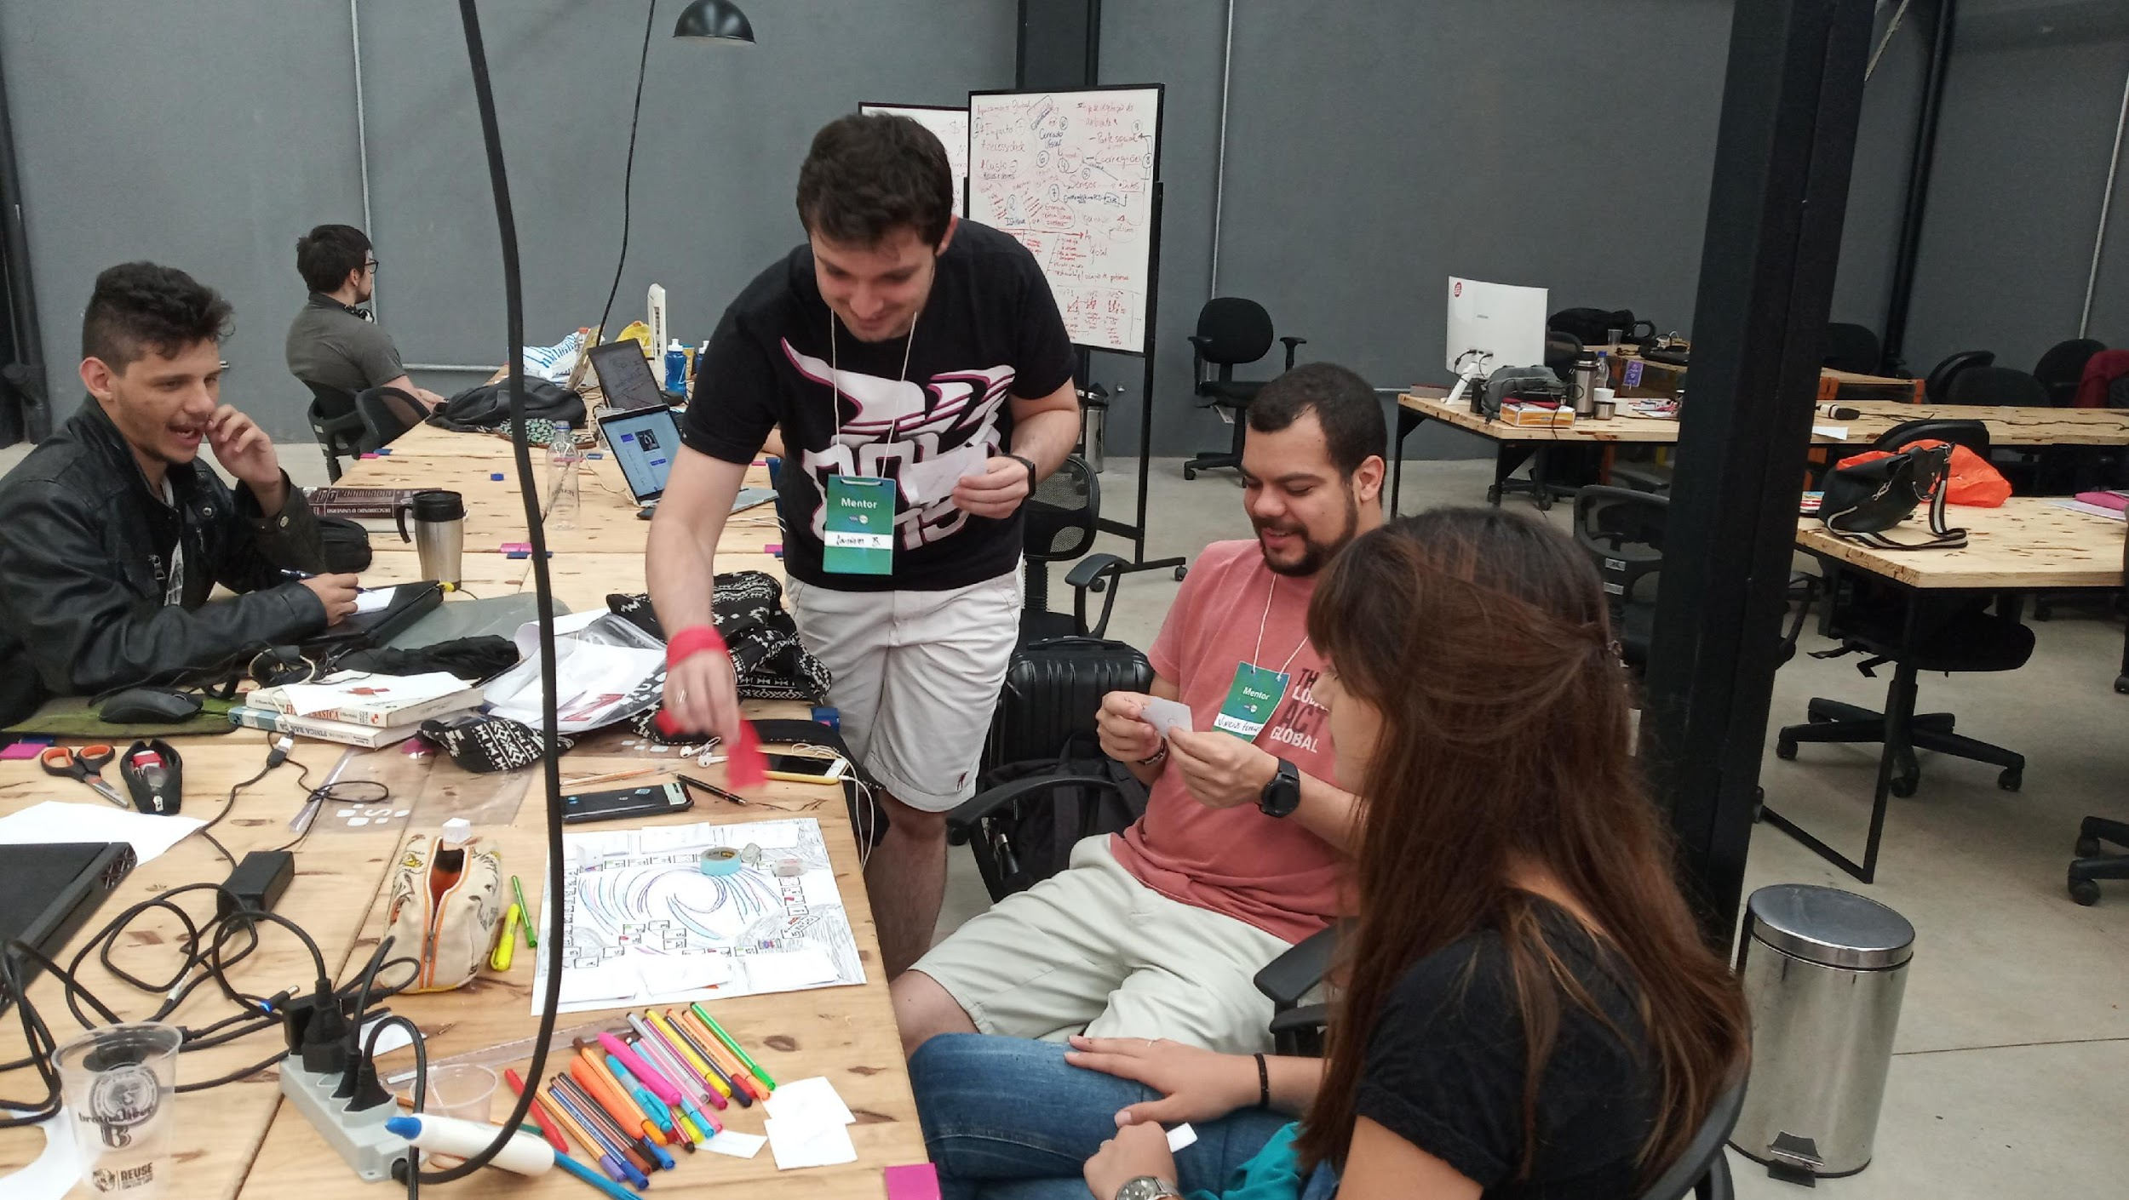
WHAT THE “ASTRONAUTES” SAID
Funny! I enjoyed understanding the properties of building a planet. I did not know that there were so many characteristics to its formation.
(Vinicius Ferreira)
An extremely interesting and engaging game. Mainly for the possibility of use with other technologies.
(Leonam Brunhari)

Slide 10
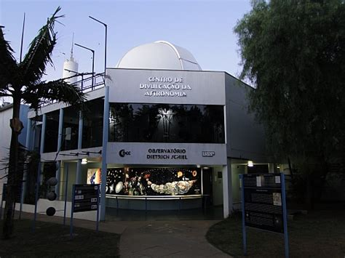
WHAT THE “ASTRONAUTES” SAID
“This kind of game would be very interesting at the CDA-CDCC (Astronomy Dissemination Center). It would help in the dissemination of astronomy knowledge in a playful way, for students of elementary and high school. ”
Valter Luiz Líbero
FCI / FT - Theoretical Physics Group

Slide 11
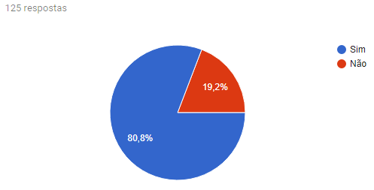
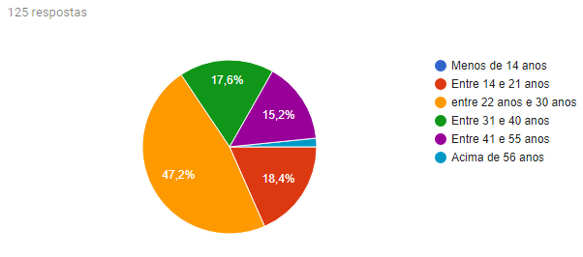
THE DEFINITIVE QUESTION
Would you buy a board game (physical or virtual) that would allow you to learn the basics of astronomy with NASA official data to play with your friends, family or students (if you are a teacher)?

Slide 12
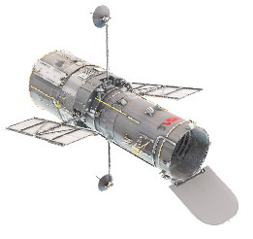
ESTIMATED COST
Sheet A3: R$ 0,50
20 A4 sheets: R$ 1,60
Impression: R$ 9,70
TOTAL: R$ 11,80

Slide 13
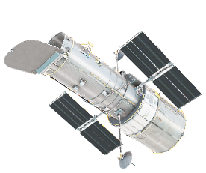
NEXT STEPS
Achieve being among NASA's selected projects
Create digital, online and multiplayer version
Create a low-cost, affordable physical version of the game as a public printable file (approximate value R$ 11,80)

Slide 14
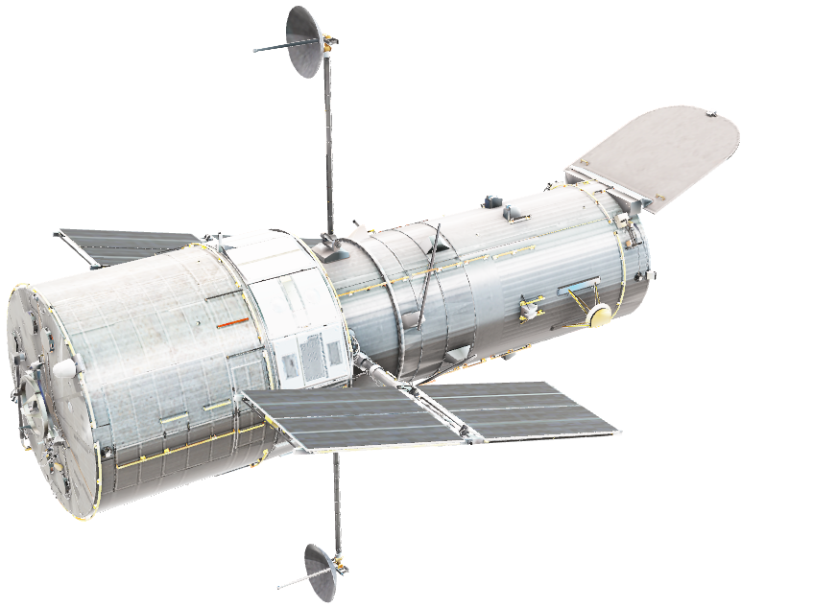
TEAM
Ana Rachel Bernardi Ferracini
Graduating in chemical engineering
Anderson Araujo de Oliveira
Graduating in Computational Physics
Clara Castellon Cunha
Graduating in Environmental Engineering
César Augusto Pessôa
Project Management Specialist
Victor Richard Cardoso
Graduating in Computational Physics

Slide 15
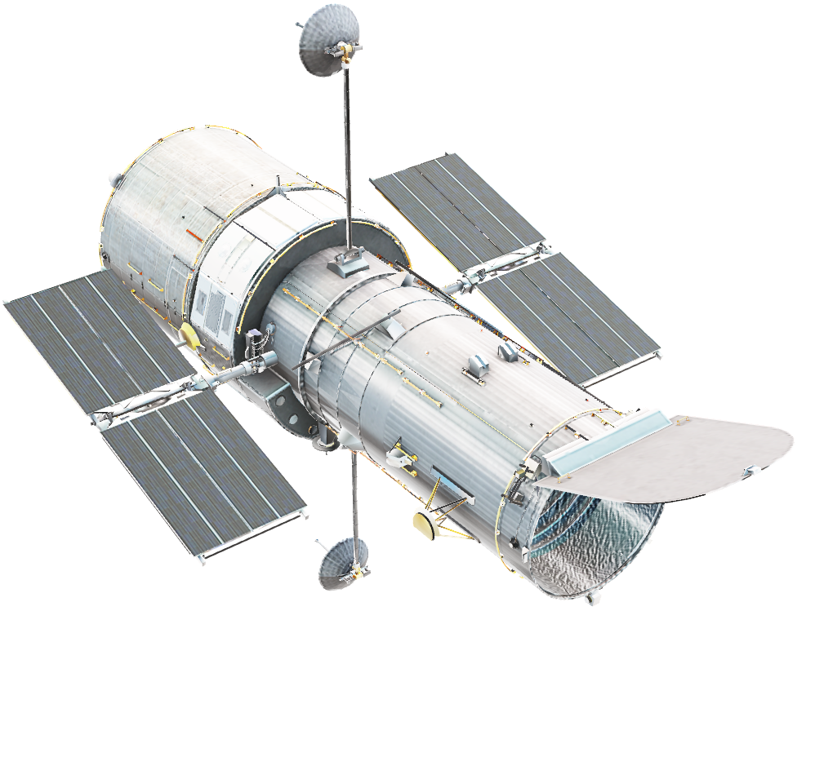

Houston, we have a Solution!
Thank you!

